Slide 1
Application Scenarios in 6G mobile systems
(2030)

Slide 2
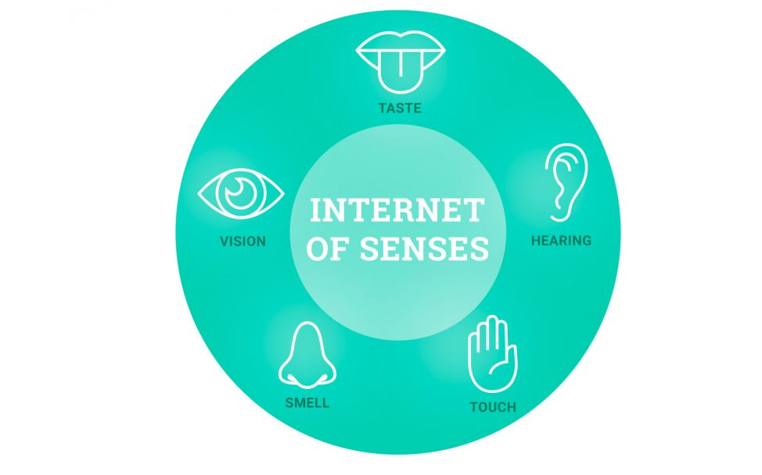

Slide 3
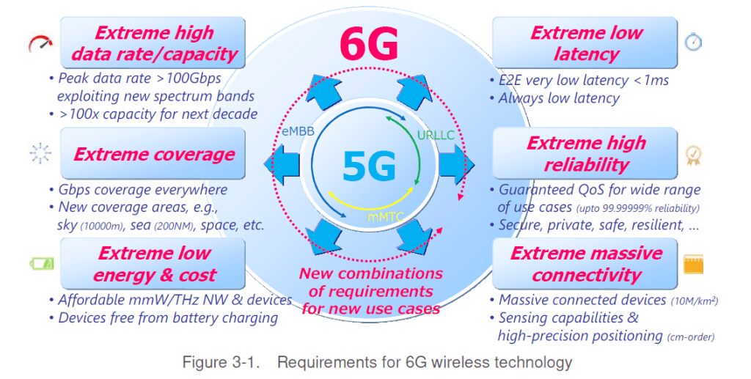
From 5G to 6G

Slide 4
Edge Computing
Deployed starting from 5G
Computation at the edge of the network
Reduction of latency and more security

Slide 5
Spectrum
7 GHz - 20 GHz, transmission over longer distances
100 GHz - 1 THz, transmission of huge amount of data
400-790 THz, VLC (Visible Light Communication)

Slide 6
CRN (Cognitive Radio Network)
AI applied to mobile networks
Networks automatization increases their performances
Optimization of resource utilizations, encryption and security

Slide 7
DTN (Digital Twin Network)

Slide 8

Quantum communication

Slide 9
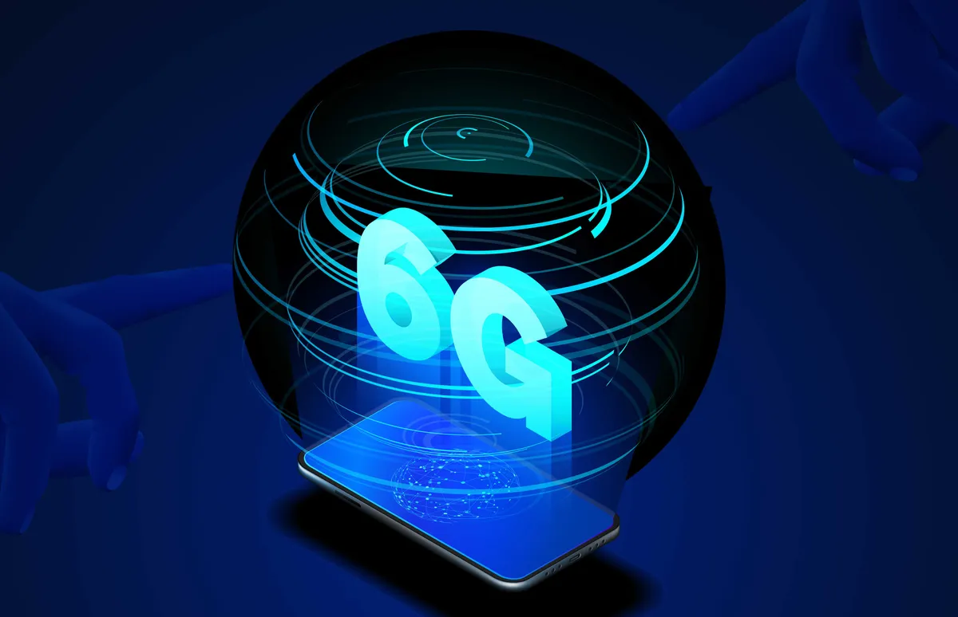
Holographic and telepresence

Slide 10
Innovative antennas
Cell free massive MIMO
Fluid antennas
IRS (Intelligent Reflecting Surface)
LIS (Large Intelligent Surface)

Slide 11
Ground-sea-air-space expected network

Slide 12
E-Health

Slide 13
UAV (Unmanned Aerial Vehicles) Network

Slide 14
Factory of the future

Slide 15
CAV (Connected Autonomous Vechicles)

Slide 16
Smart World

Slide 17
THANK YOU

